Slide 1

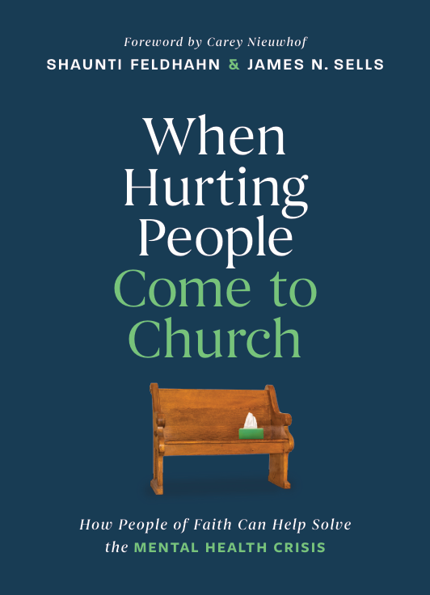
Mental Health in the Church Today
The Leadership Views of 2,000 Pastors, Counselors and Coaches
Shaunti Feldhahn and Dr. Jennifer Ripley

Slide 2

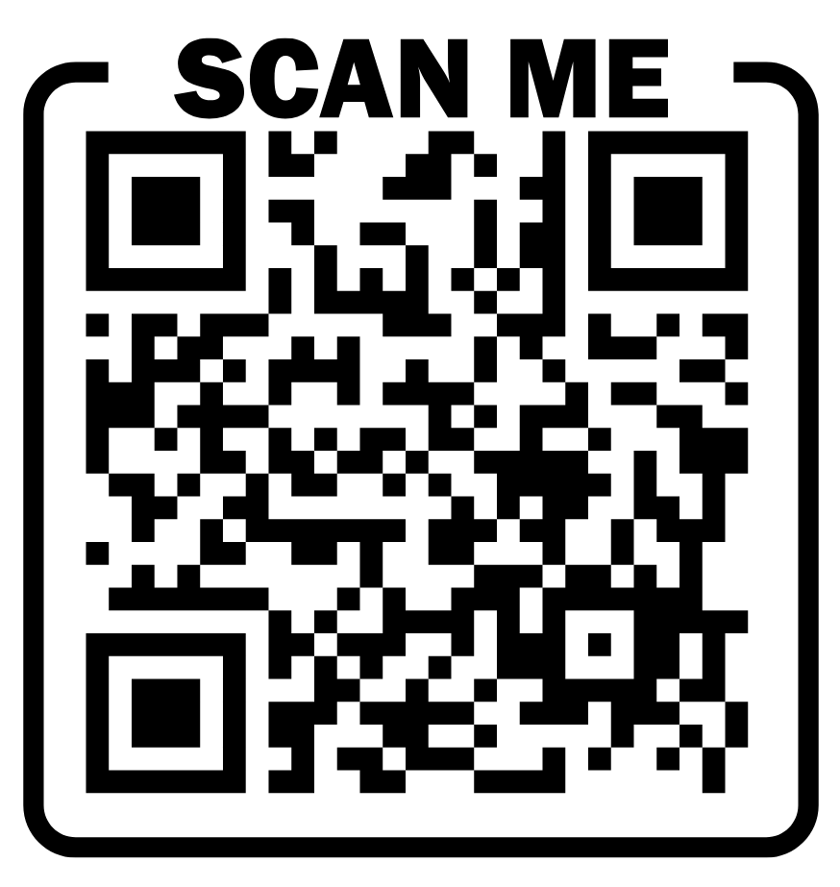
For the slides from this talk
Shaunti.com/aacc2025
Shaunti Feldhahn and Jennifer Ripley, 2025 / The Church Cares

Slide 3
The Problem
Shaunti Feldhahn and Jennifer Ripley, 2025 / The Church Cares

Slide 4
“…a global crisis for mental health”
--World Health Organization
Shaunti Feldhahn and Jennifer Ripley, 2025 / The Church Cares

Slide 5
“…a global crisis for mental health”
--World Health Organization
U.S. adults with mental illness (anxiety, depression, addiction, etc.)
59.3 million
50%
Percentage not receiving care
Sources:
World Health Organization. (2022).
World mental health report: transforming mental health for all.
National Institutes of Mental Health
https://www.nimh.nih.gov/health/statistics/mental-illness
Shaunti Feldhahn and Jennifer Ripley, 2025 / The Church Cares

Slide 6

One in every four U.S. adults is dealing with significant mental and emotional pain.
One in every eight has nowhere to turn.
Similar ratios among adolescents.
Source for adolescent data: https://mchb.hrsa.gov/sites/default/files/mchb/data-research/nsch-data-brief-adolescent-mental-behavioral-health-2023.pdf
Shaunti Feldhahn and Jennifer Ripley, 2025 / The Church Cares

Slide 7

Too much demand for mental health services, not enough supply of caregivers
Shaunti Feldhahn and Jennifer Ripley, 2025 / The Church Cares

Slide 8
Real consequences of
the gap in supply vs. demand
109,000 fewer counselors than needed = those in pain unable to access care.
81.5% of psychiatrists not taking new patients = medical issues aren’t getting attention.
Wait times skyrocketing. AMA secret shopper study found 20% of tele-mental-health clinics didn’t call back after three tries.
Health Resources & Services Administration. Workforce projections. HHS. As of 5/2025 https://data.hrsa.gov/topics/health-workforce/workforce-projections.
Cantor, J., Schuler, M. S., Matthews, S., Kofner, A., Breslau, J., & McBain, R. K. (2024). Availability of mental telehealth services in the US. JAMA Health Forum, 5(2), e235142-. https://doi.org/10.1001/jamahealthforum.2023.5142
Sun, C-F., Correll, C. U., Trestman, R. L., Lin, Y., Xie, H., Hankey, M. S., Uymatiao, R. P., Patel, R. T., Metsutnan, V. L., McDaid, E. C., Saha, A., Kuo, C., Lewis, P., Bhatt, S. H., Lipphard, L. E., & Kablinger, A. S. (2023). Low availability, long wait times, and high geographic disparity of psychiatric outpatient care in the US. General Hospital Psychiatry, 84, 12-17. https://doi.org/10.1016/j.genhosppsych.2023.05.012
Shaunti Feldhahn and Jennifer Ripley, 2025 / The Church Cares

Slide 9
Real consequences of high costs
& providers not taking insurance
Johns Hopkins study:
Among adults with depression or anxiety and medical debt (common in that population):
Among adults w/ depression or anxiety and no medical debt:
Did get care
25%
Did not get care
35%
Did not get care
75%
Did get care
65%
Source: https://publichealth.jhu.edu/2024/adults-with-depression-or-anxiety-more-likely-to-have-medical-debt-delay-care
Shaunti Feldhahn and Jennifer Ripley, 2025 / The Church Cares

Slide 10
One in every four U.S. adults is dealing with significant mental and emotional pain.
One in every eight has nowhere to turn.
Similar ratios among adolescents.
Source for adolescent data: https://mchb.hrsa.gov/sites/default/files/mchb/data-research/nsch-data-brief-adolescent-mental-behavioral-health-2023.pdf
Shaunti Feldhahn and Jennifer Ripley, 2025 / The Church Cares

Slide 11

What’s the cause?
Shaunti Feldhahn and Jennifer Ripley, 2025 / The Church Cares

Slide 12
According to the Global Flourishing Study
Loneliness increases risk of premature death by 30% = 15 cigarettes a day.
Greater risk of stroke, dementia, heart disease, anxiety, depression.
Being alone is extremely difficult for the human mind and heart.
Yet large numbers have zero friends.
Loneliness
Shaunti Feldhahn and Jennifer Ripley, 2025 / The Church Cares

Slide 13

Global Flourishing Study
VanderWeele et al., (2025) Nature article:
USA Top Concerns “Satisfying Relationships” “Trust” and “Belonging” (Table 9)
Globally, well-being is related to relationship factors
Relationships are a Global Health Concern
Marriage, Employment, Religious Service Attendance
Source: https://www.nature.com/articles/s44220-025-00423-5
Shaunti Feldhahn and Jennifer Ripley, 2025 / The Church Cares

Slide 14

Where do we fit?
Shaunti Feldhahn and Jennifer Ripley, 2025 / The Church Cares

Slide 15

The church has an opportunity
Shaunti Feldhahn and Jennifer Ripley, 2025 / The Church Cares

Slide 16
The church is relationships;
the Body of Christ
“Therefore, as God’s chosen people, holy and dearly loved, clothe yourselves with compassion, kindness, humility, gentleness and patience. Bear with each other and forgive one another if any of you has a grievance against someone. Forgive as the Lord forgave you. And over all these virtues put on love, which binds them all together in perfect unity. Let the peace of Christ rule in your hearts, since as members of one body you were called to peace.” - Colossians 3:12-15
Shaunti Feldhahn and Jennifer Ripley, 2025 / The Church Cares

Slide 17

What the church thinks
about mental health
Shaunti Feldhahn and Jennifer Ripley, 2025 / The Church Cares

Slide 18
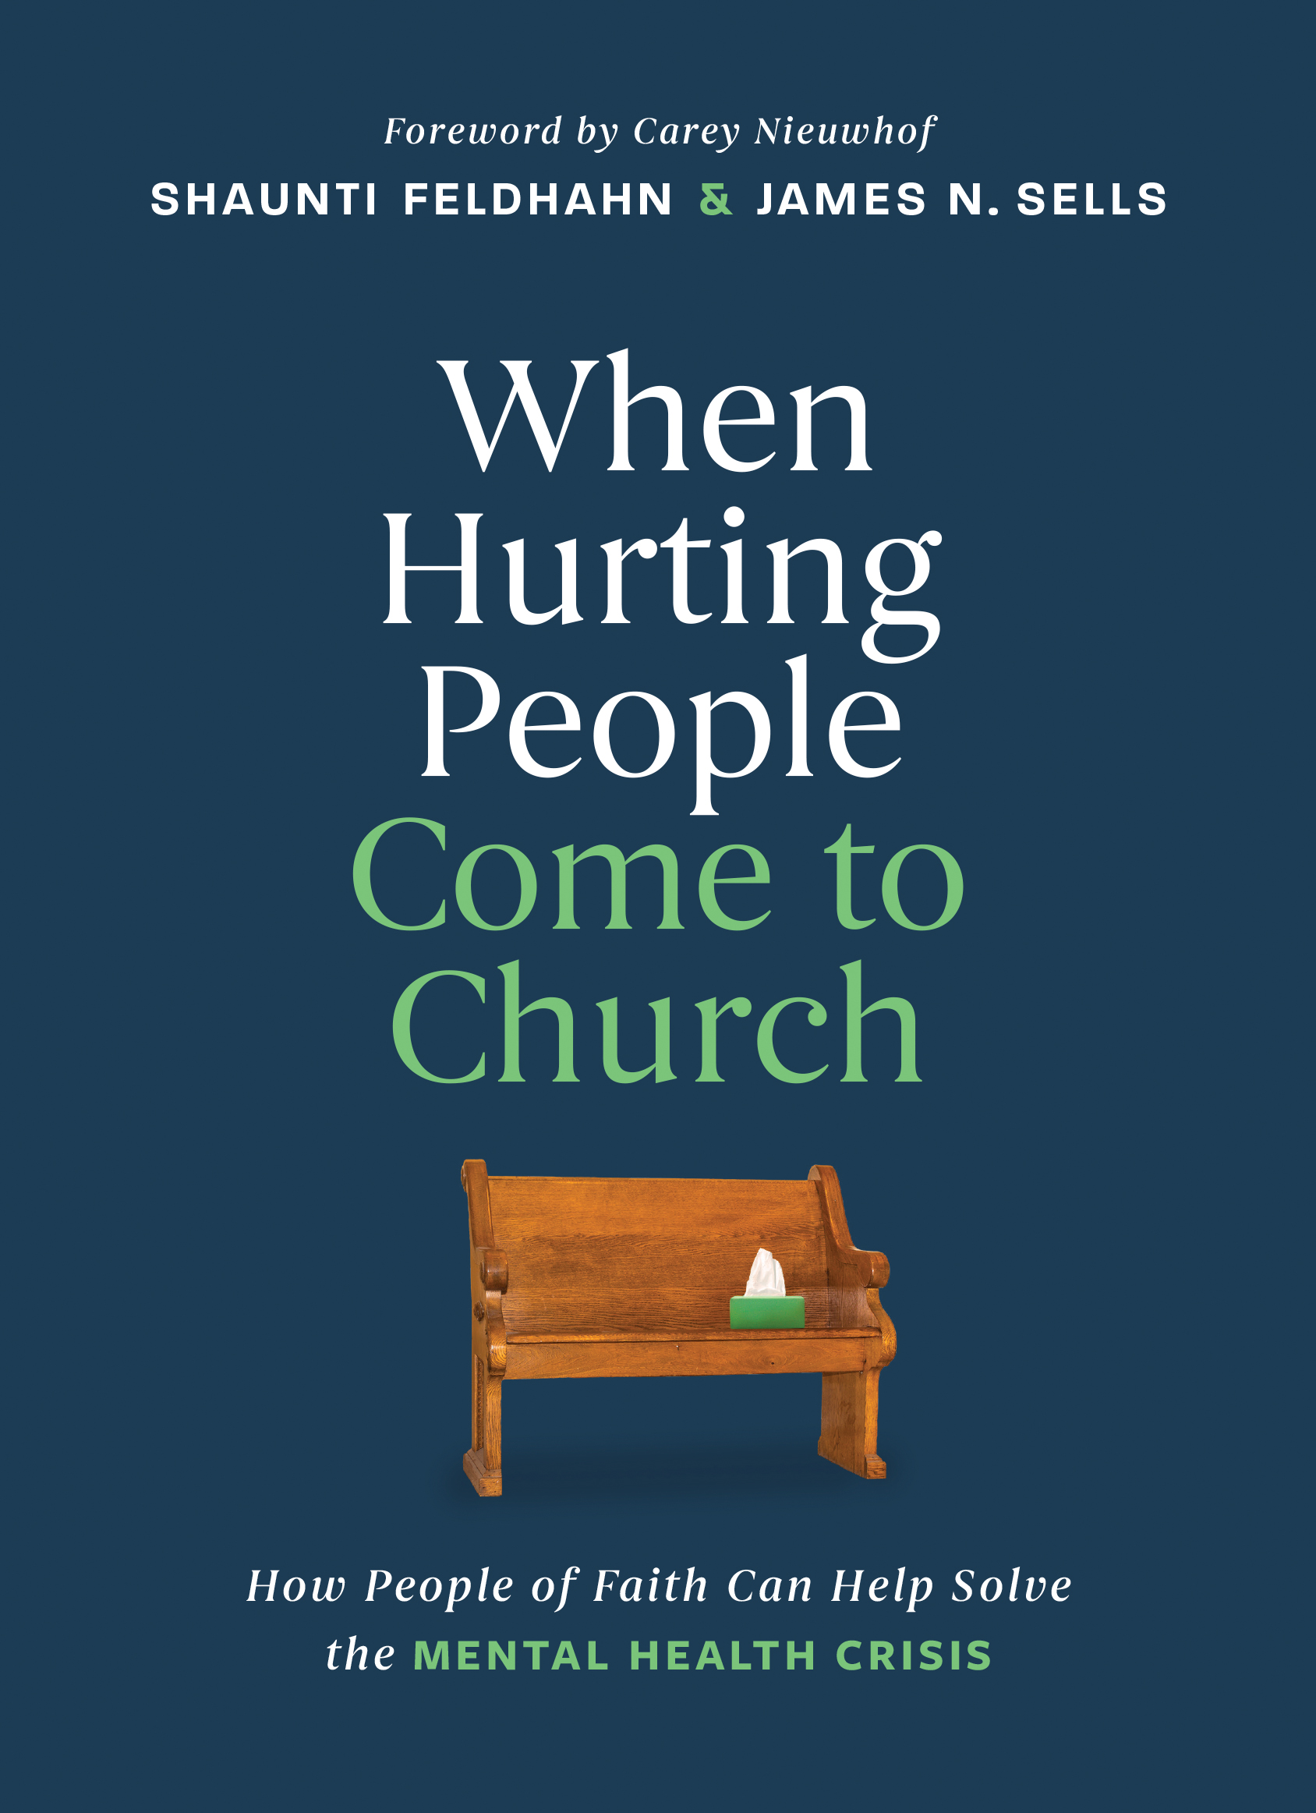
Study of 2,000 Pastors
What is the church already doing?
What are church leaders’ perspectives around mental health?
Shaunti Feldhahn and Jennifer Ripley, 2025 / The Church Cares

Slide 19
A clear need in the church
Disagree
19%
“Mental health issues are common among people in my church.”
Agree / Somewhat Agree
81%
  “The current mental health need in my church is greater than I can address alone.”
  (Note: 86% of those who disagree say mental health issues are simply not common in their church.)
Agree /
Somewhat Agree
Disagree
20%
Agree / Somewhat Agree
80%
Shaunti Feldhahn and Jennifer Ripley, 2025 / The Church Cares

Slide 20
A clear need in the church
“Our church has an effective process in place; we are doing a good job of addressing the mental health needs of our people.”
68%
32%
Agree /
Somewhat Agree
Agree
Disagree / Somewhat Disagree
Shaunti Feldhahn and Jennifer Ripley, 2025 / The Church Cares

Slide 21
Pastors are Conflicted
“If a person’s presenting issue is psychological rather than spiritual, the church’s primary mental health service should be to refer to a professional.”
Disagree
12%
Agree / Somewhat Agree
88%
Disagree
4%
Agree /
Somewhat Agree
  “A community of believers supporting one another is one of the best ways to foster good mental health inside the church.”
Agree / Somewhat Agree
96%
Shaunti Feldhahn and Jennifer Ripley, 2025 / The Church Cares

Slide 22
A clear solution
“Most people with mental health issues can be greatly helped by spending time with a Christian lay counselor /coach who will listen to them and walk alongside them for a season.”
94%
Agree /
Somewhat Agree
6%
Agree/Somewhat Agree
Disagree
Shaunti Feldhahn and Jennifer Ripley, 2025 / The Church Cares

Slide 23
A step to be taken
(Among those who agreed) “Are there laypeople in your church trained in listening in that way? Does that type of ministry exist in your church?*
62%
38%
Agree /
Somewhat Agree
*Average of those who agreed, who also:
answered “agree/strongly agree” to the question “there are lay people in my church who are adequately trained to address basic mental health needs” (37.7%), and
listed such a ministry (lay listening/basic care and support such as Stephen Ministry, lay counseling/coaching, or inner healing) as existing in their church (38.9%)
YES
NO
Shaunti Feldhahn and Jennifer Ripley, 2025 / The Church Cares

Slide 24

What we think is needed
Shaunti Feldhahn and Jennifer Ripley, 2025 / The Church Cares

Slide 25
The church (meaning, the people in it) are the key to care
Church Peer Support
Christian love
Prayer
Lived experience
Long-term relationships
. . . and it costs nothing but time.
Shaunti Feldhahn and Jennifer Ripley, 2025 / The Church Cares

Slide 26
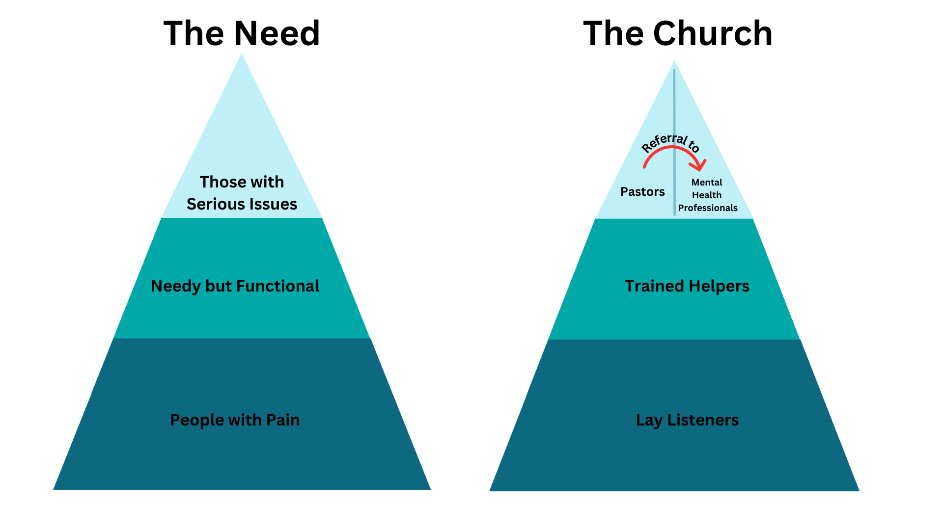
A New Model
Shaunti Feldhahn and Jennifer Ripley, 2025 / The Church Cares

Slide 27
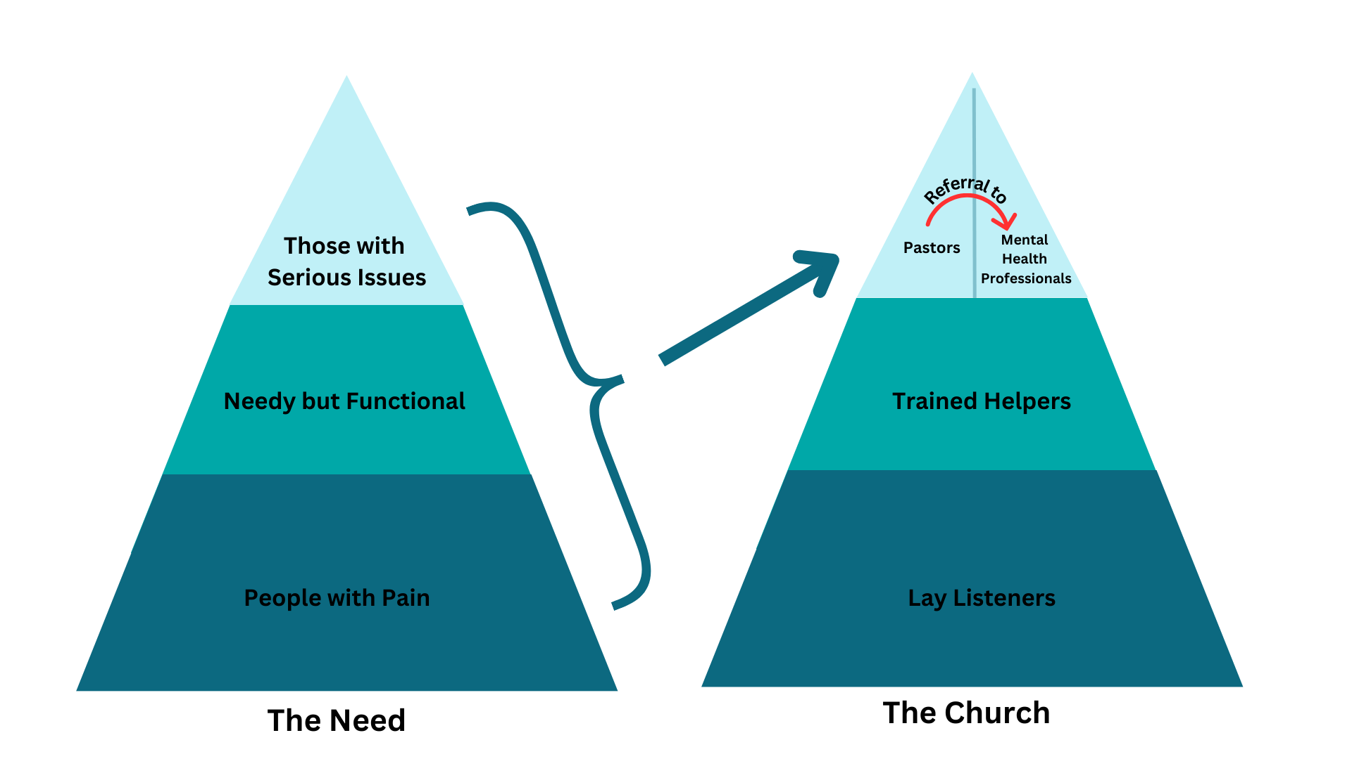
What happens today
Shaunti Feldhahn and Jennifer Ripley, 2025 / The Church Cares

Slide 28
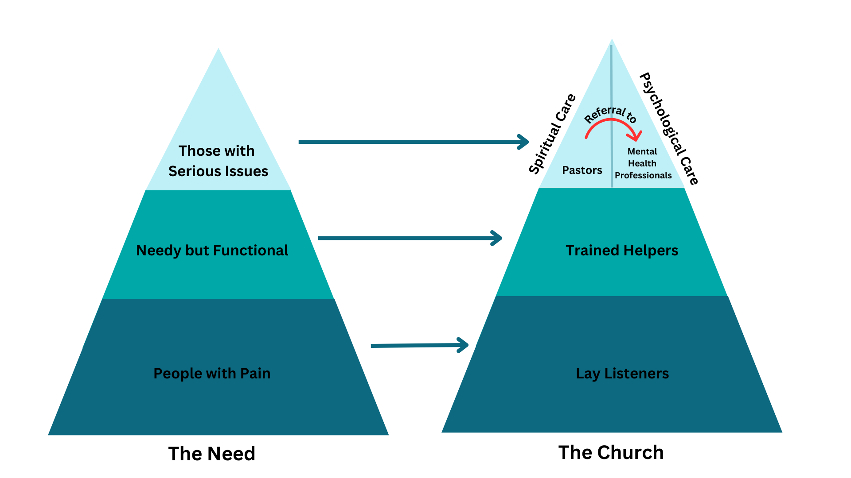
What needs to happen
Shaunti Feldhahn and Jennifer Ripley, 2025 / The Church Cares

Slide 29
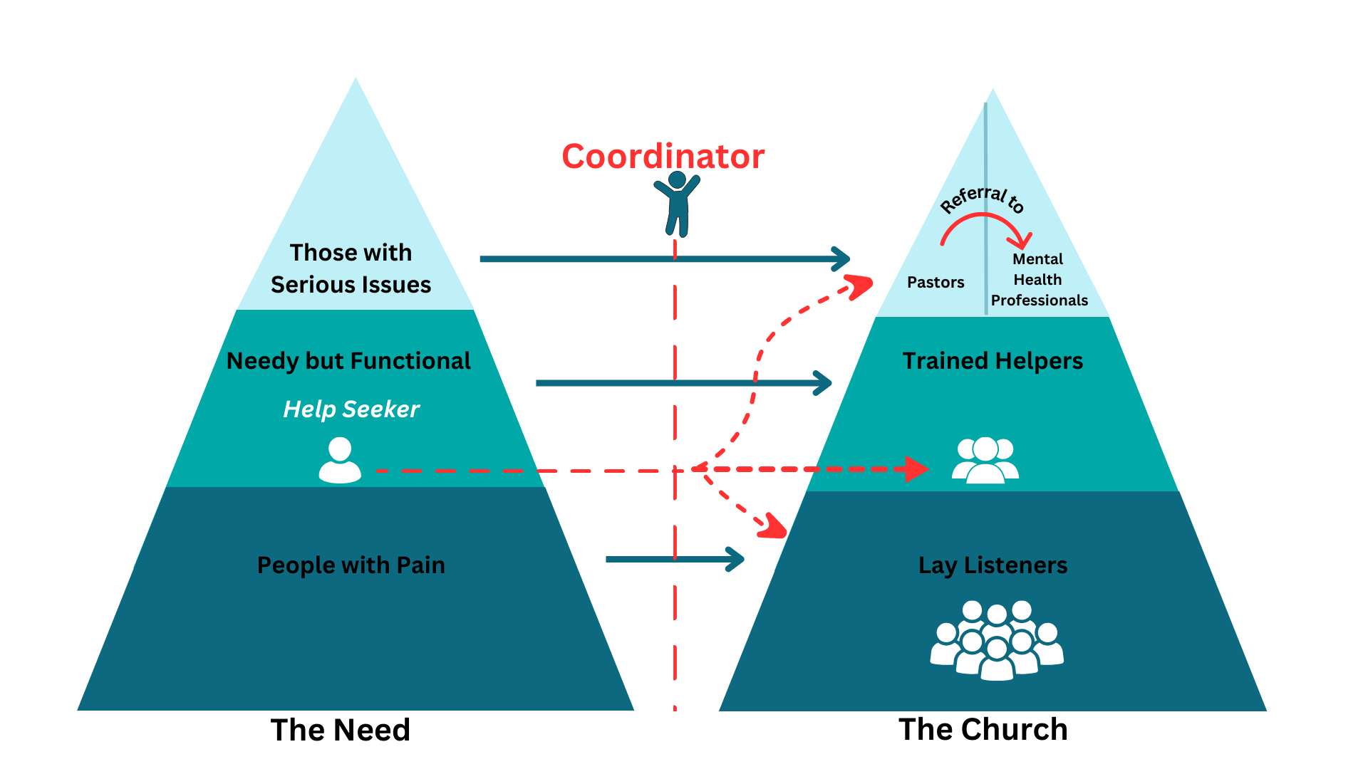

The Church CARE Strategy
Shaunti Feldhahn and Jennifer Ripley, 2025 / The Church Cares

Slide 30

Lay helping works
Shaunti Feldhahn and Jennifer Ripley, 2025 / The Church Cares

Slide 31
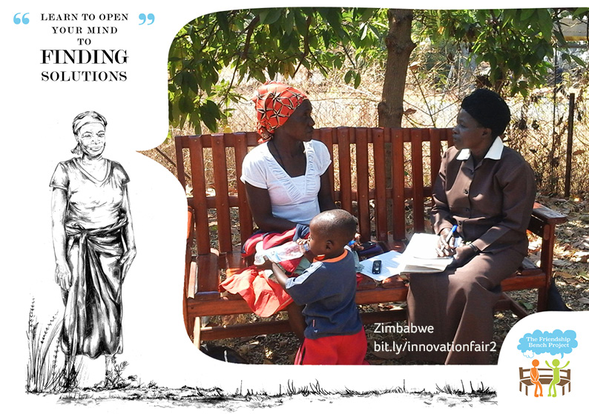
The
Friendship Bench
Shaunti Feldhahn and Jennifer Ripley, 2025 / The Church Cares

Slide 32
“Peer counseling” or “peer support” produces
over 17K articles in PsycINFO
Post-partum care, suicide prevention, elder loneliness
Global Phenomenon
Evidence Based Approach to address health and mental health concerns
Primarily through Self-Determination Theory
Ryan et al. (2022) review of 60 meta-analyses of Self-Determination Theory demonstrating validity to the theory applied to many settings, including peer support.
Shaunti Feldhahn and Jennifer Ripley, 2025 / The Church Cares

Slide 33
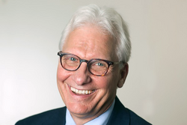
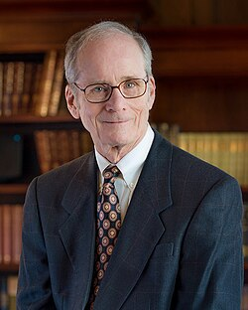
Is Self-Determination Theory Credible?
Ryan et al. (2022) review of 60 meta-analyses of Self-Determination Theory demonstrating validity to the theory applied to many settings, including peer support.
Notes:
Jen - 1 minute or less
You don’t get more credibility than 60 meta -analyses.. Explain with a meta analysis is.
Picture Richard Ryan, And Edward Deci both U Rochester Taken from Wikipedia Co-creators of much of the research on self-determination theory
Ryan, R. M., Duineveld, J. J., Di Domenico, S. I., Ryan, W. S., Steward, B. A., & Bradshaw, E. L. (2022). We know this much is (meta-analytically) true: A meta-review of meta-analytic findings evaluating self-determination theory. Psychological Bulletin, 148(11-12), 813–842. https://doi.org/10.1037/bul0000385
Abstract
Self-determination theory (SDT) is a theoretical framework for addressing human motivation and wellness that has been actively and increasingly researched over 4 decades. As a cumulative knowledge base, many of SDT’s fundamental tenets have been repeatedly examined. We identified 60 meta-analyses that tested many of the propositions of SDT’s six mini-theories, other theory-based hypotheses, and SDT’s utility in applied domains. In this review, we examine what these meta-analyses establish, highlighting the support they lend to the validity of SDT’s motivational taxonomy and its hypotheses regarding the respective effects of basic psychological need satisfaction and frustration on well-being and ill-being. Meta-analytic evidence also strongly supports the relevance of SDT for organizations, health care, parenting, and education among other domains, with identifiable gaps in the meta-analytic literature. We conclude by discussing the importance of broad theory and the use of meta-analytic knowledge as scaffolding for further theory and research, albeit with its own methodological limitations. (PsycInfo Database Record (c) 2023 APA, all rights reserved)

Slide 34
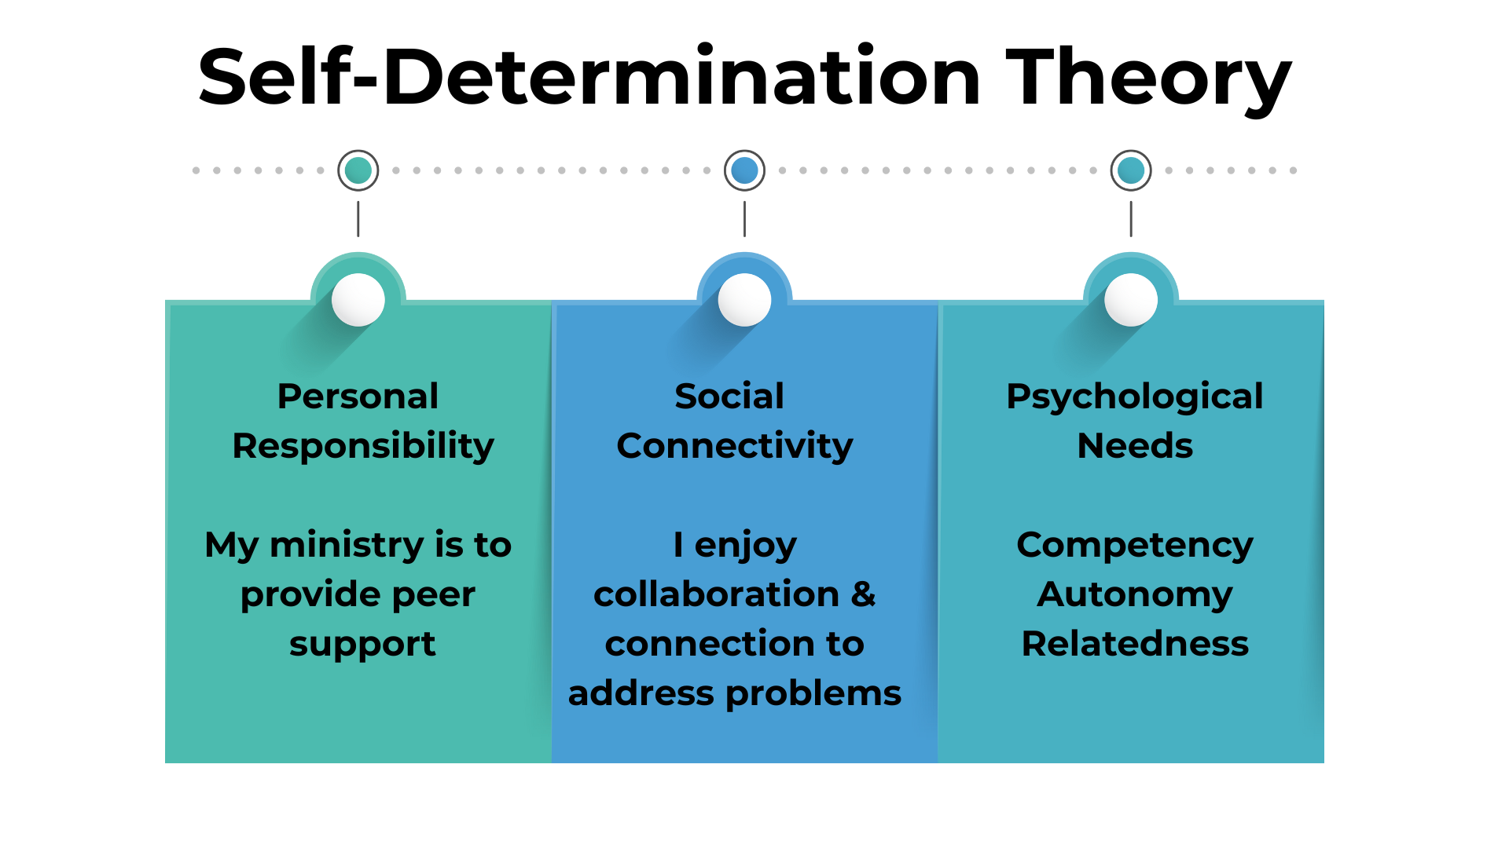
Here’s How
Notes:
Jen- 3-4 minutes
Image created in Canva if needs revisions
The theory behind peer helping is usually self-determination theory which has a deep well of research support
While complex, I am going to focus on a few relevant aspects of it
When providing peer support, there needs to be a sense of personal responsibility. parable of the Good Samaritan. The Samaritan took personal responsibility for someone who was in need. For peer helping to be effective the hepler needs to see themselves as someone who provides the ministry of peer support.
Social Connectivity. The helper needs to see the problems that they are trying to address as something that can be helped through collaboration and connection. The helper must believe that if I put my lived experiences and basic training, together with the help-seekers abilities, our church’s resources, and God’s direction we have the social connections there to address most problems.
There are 3 values of SDT-
Competency- the task is suited to one’s life situation. I have information that is relevant. I can encourage and support. Can promote competency in the help-seeker.
Autonomy- I am not controlling, I acknowledge personal perspective and emphasize personal responsibility. Each person answers to God for their choices.
Relatedness- valuing a sense of connection and collaboration, promote relatedness in the help-seeker
Wikipedia has a good summary for me to review prior to presentation in case I get questions about it: https://en.wikipedia.org/wiki/Self-determination_theory

Slide 35
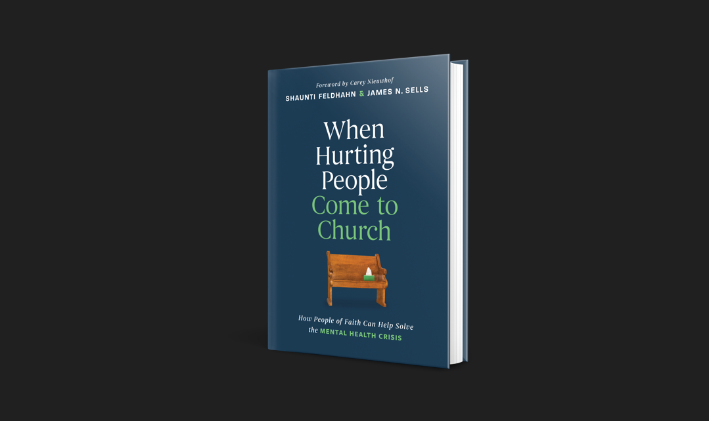

Slide 36

TheChurchCares.com

Slide 37

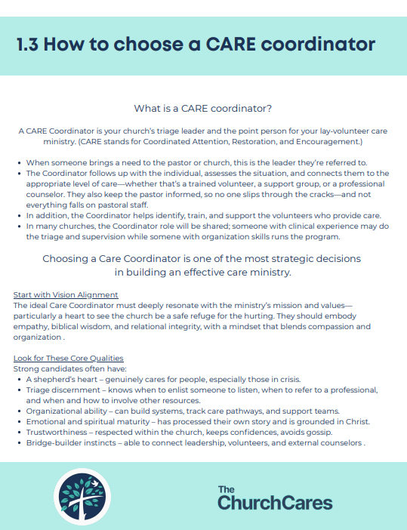
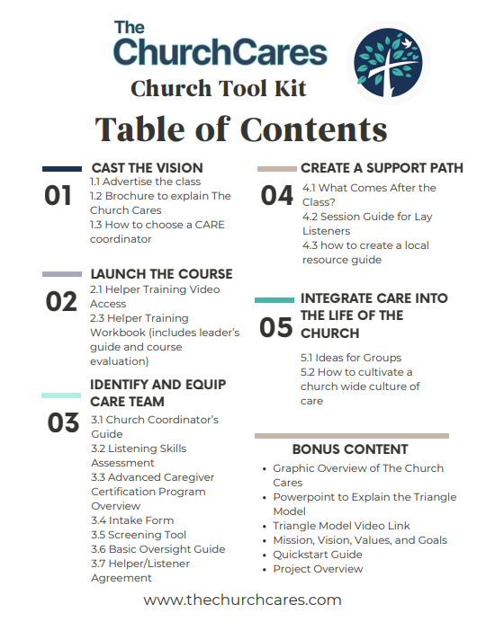
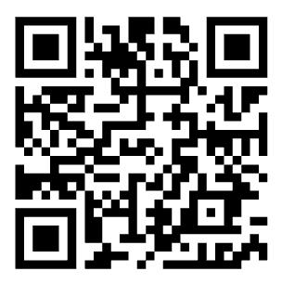
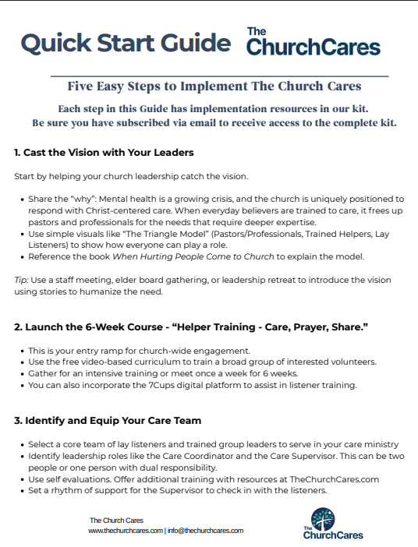
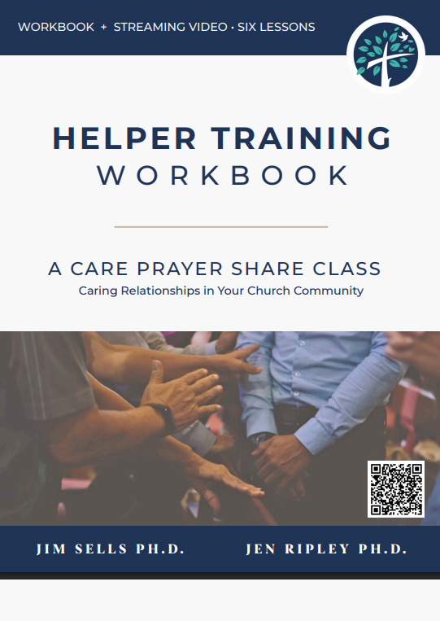

Slide 38
For the slides from this talk
Shaunti.com/aacc2025
Shaunti Feldhahn and Jennifer Ripley, 2025 / The Church Cares

